Slide 1

Show me the data!
&
Week09: Text Mining
Social Analysis
Big Data
R
Instructors：Chung-pei Pien
ZU1942001/266868001/Z23937001/ZM1941001

Slide 2
C
ONTENTS
1
Introduction of Text Mining
2
Loop
3
JSON and Loop
4
Read Files and Loop
5
Assignment

Slide 3
Text Mining

Slide 4

01
Introduction of Text Mining
Text Mining:
is the process of transforming unstructured text into a structured format to identify meaningful patterns and new insights (IBM Cloud Education 2020).

Slide 5
01
Introduction of Text Mining
There are many text mining techniques, such as word frequency, word association, sentiment analysis, topic model, RNN, CNN, and so on.
These techniques use different ways to reduce words into vectors represented by real numbers.

Slide 6
01
Introduction of Text Mining
✓
Word Frequency | To calculate terms’ occurrence number in documents
Word Association | To show the extent to which pairs of terms are related.
Sentiment Analysis | The degree of positive, neutral, or negative strength of the sentiment contained in a body of text
TF-IDF | To calculate how important a word is to documents
Topic Model | To discover how words and phases can characterize the documents
RNN, CNN | Neural network in machine learning
✓
✓

Slide 7
01
Introduction of Text Mining
Word Frequency
ICI is great.
NCCU is great.
Big data is so easy.
I love big data courses of ICI, NCCU.
ICI offer 10 great courses.
ICI: 3
NCCU: 2
Great: 3
Data: 2

Slide 8
01
Introduction of Text Mining
Word Association
ICI is great.
NCCU is great.
Big data is so easy.
I love big data courses of ICI, NCCU.
ICI offer 10 great courses.
ICI
Great: 0.33
NCCU: 0.33

Slide 9
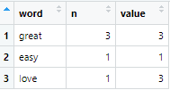
01
Introduction of Text Mining
Sentiment Analysis
ICI is great.
NCCU is great.
Big data is so easy.
I love big data courses of ICI, NCCU.
ICI offer 10 great courses.

Slide 10
tidytext

Slide 11
02
tidytext
There are two popular text mining packages in R:
tm: a classic text mining package
tm can show you the detail of text mining processes.
tidytext: an efficient tool for text mining in R, merging with dplyr package.
✓

Slide 12
02
tidytext
The first step to use tidytext to do text mining is to tokenize your text.
What is tokenize?
To transform your text into a dataframe that one obersvation records a single word and the ID of the word’s line, sentence, paragraph, or chapter.

Slide 13
02
tidytext
ici <- c("ICI is great",
"NCCU is great",
"Big data is so easy",
"I love big courses of ICI, NCCU",
"ICI offer 10 great courses")
ici_df <- data.frame(line = 1:5,
text = ici
stringsAsFactors = FALSE)

Slide 14
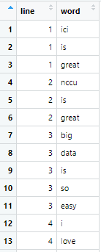
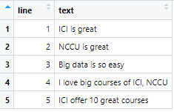
02
tidytext
Let’s tokenize ici_df
ici_tokens <- ici_df %>%
unnest_tokens(word, text)

Slide 15
Word Frequency

Slide 16
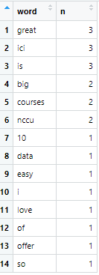
03
Word Frequency
Introduction
To show the extent to which pairs of terms are related.
ici_frq <- ici_tokens %>%
group_by(word) %>%
summarise(number = n()) %>%
arrange(desc(number))
or
ici_frq_c <- ici_tokens %>%
count(word, sort = TRUE)

Slide 17

03
Word Frequency
Word Cloud
library(wordcloud2)
wordcloud2(ici_frq_c)

Slide 18
03
Word Frequency
Introduction
Before we start our exercise of text in reality, there is an important step:
Clean data
We want to remove words and symbols that do not have any impact on the meaning to it (Khalid 2020).
Case by case: segmentation (2-byte language), symbols, numbers, emoji, urls, hash tags, stop words…….
Notes:
https://towardsdatascience.com/text-mining-with-r-gathering-and-cleaning-data-8f8b0d65e67c

Slide 19
03
Word Frequency
Introduction
ici <- c("ICI is great",
"NCCU is great",
"Big data is so easy",
"I love big courses of ICI, NCCU",
"ICI offer 10 great courses")
ici <- gsub("[[:digit:]]", "", ici)
ici_df <- data.frame(line = 1:5,
text = ici
stringsAsFactors = FALSE)
Notes:
https://towardsdatascience.com/text-mining-with-r-gathering-and-cleaning-data-8f8b0d65e67c

Slide 20
03
Word Frequency
Introduction
# Set the text to lowercase
text <- tolower(text)
# Remove urls, emojis, numbers, punctuations, etc.
text <- gsub("https?://.+", "", text)
#text <- gsub(" ?(f|ht)(tp)(s?)(://)(.*)[.|/](.*)", " ", text)
text <- gsub("\\d+\\w*\\d*", "", text)
text <- gsub("[^\x01-\x7F]", "", text)
text <- gsub("[[:punct:]]", " ", text)
# Remove spaces and newlines
text <- gsub("amp;", "", text)
text <- gsub("\n", " ", text)

Slide 21
03
Word Frequency
Introduction
Remove or replace emojis
Remove is not perfect.
emoji <- c("1: 😊", "2: 😍")
emoji_remove <- gsub("[^\x01-\x7F]", "", emoji)
emoji_remove
Notes:
https://stackoverflow.com/questions/67576269/how-can-i-replace-emojis-with-text-and-treat-them-as-single-words

Slide 22
03
Word Frequency
Introduction
converse emojis to words
library(lexicon)
emoji_dic <- hash_emojis
library(textclean)
emoji_rp <- replace_emoji(emoji, emoji_dt = emoji_dic)
emoji_rp

Slide 23
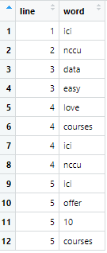
03
Word Frequency
Introduction
Use stop words dictionary provided by tidytext
ici_tokens_s <- ici_df %>%
unnest_tokens(word, text) %>%
anti_join(stop_words)

Slide 24
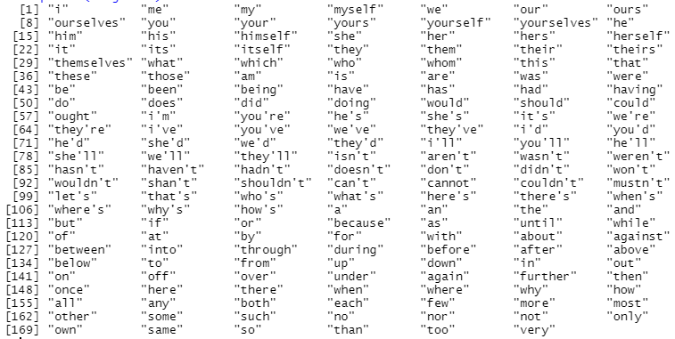
03
Word Frequency
Introduction
Use stop words dictionary provided by tm
Library(tm)
stopwords("English"))

Slide 25
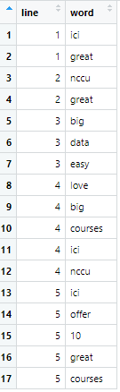
03
Word Frequency
Introduction
ici_tokens_tm <- ici_df %>%
unnest_tokens(word, text) %>%
filter(!word %in% stopwords("English"))

Slide 26
03
Word Frequency
Introduction
You can create your stop word list.
mystopword <- data.frame(stopword = c("ici", "nccu"))
ici_tokens_my <- ici_df %>%
unnest_tokens(word, text) %>%
filter(!word %in% stopwords("English"),
!word %in% mystopword$stopword)

Slide 27
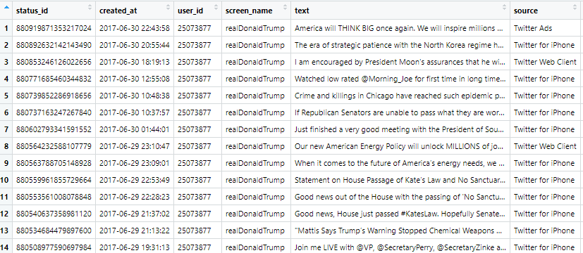
03
Word Frequency
Introduction
Let’s do text mining of Trump’s tweets

Slide 28
03
Word Frequency
Introduction
trump_tweet <- read_xlsx("trumptweets.xlsx")
text <- trump_tweet$text
Text cleaning
Run the text cleaning codes you want
text <- gsub("https?://.+", "", text)

Slide 29
03
Word Frequency
Introduction
2. Assign text as a new column of trump_tweet
trump_tweet$new_text <- text
3. Select rows and columns
trump_temp <- trump_tweet %>%
filter(is_retweet == FALSE) %>%
select(status_id, new_text)

Slide 30
03
Word Frequency
Introduction
4. Tokenize trump_tweet with stop word
trump_tokens <- trump_temp %>%
unnest_tokens(word, new_text) %>%
filter(!word %in% stopwords("English"))
5. Count word frequency
trump_frq <- trump_tokens %>%
count(word, sort = TRUE)

Slide 31
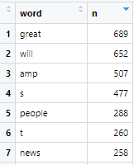
03
Word Frequency
Introduction
6. Check the result of word frequency
Go back to Step 1 and add:
text <- gsub("\\W[a-zA-Z]\\W", "", text)
Run Step 1-6 again

Slide 32
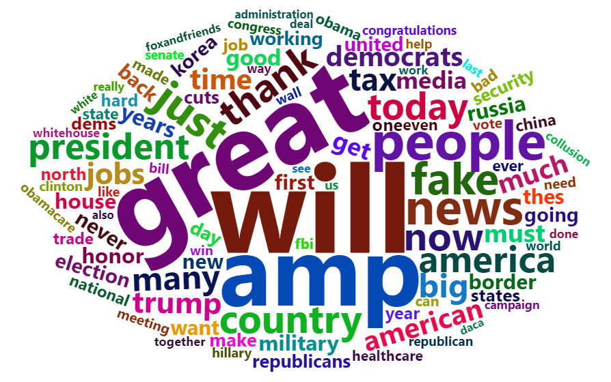
03
Word Frequency
Introduction
6. Word cloud
wordcloud2(trump_frq[1:100,], shape = "circle")

Slide 33
Word Association
Notes:
https://books.psychstat.org/textmining/association-of-words.html#pairwise-association

Slide 34
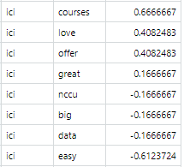
04
Word Association
Introduction
To calculate terms’ occurrence number in documents
library(widyr)
ici_cors <- ici_tokens_tm %>%
group_by(word) %>%
pairwise_cor(word, line, sort = TRUE)

Slide 35
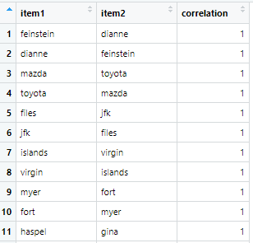
04
Word Association
Introduction
When you have tokenized tables, it’s easy to calculate word association.
trump_cors <- trump_tokens %>%
group_by(word) %>%
pairwise_cor(word, status_id, sort = TRUE)

Slide 36
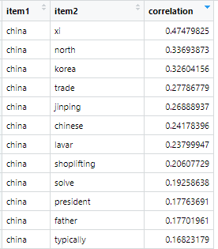
04
Word Association
Introduction
Select a word you want to analyze
trump_china <- trump_cors %>%
filter(item1 == "china")

Slide 37
Sentiment Analysis
Notes:
https://books.psychstat.org/textmining/association-of-words.html#pairwise-association

Slide 38
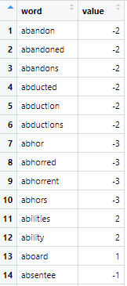
05
Sentiment Analysis
Introduction
Load a sentiment dictionary
afinn <- get_sentiments("afinn")

Slide 39
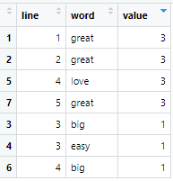
05
Sentiment Analysis
Introduction
Merge into a tokenized table:
ici_senti <- ici_tokens_tm %>%
inner_join(afinn, by = "word")

Slide 40
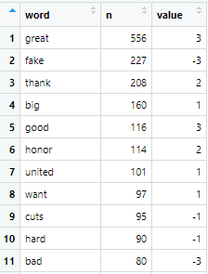
05
Sentiment Analysis
Introduction
Merge into a tokenized table:
trump_senti <- trump_frq %>%
inner_join(afinn, by = "word")

Slide 41
05
Sentiment Analysis
Introduction
Create a plot to show Trump’s tweets’ changes in sentiment by month.

Slide 42
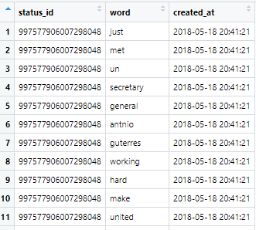
05
Sentiment Analysis
Introduction
trump_sent_all <- trump_tokens %>%
left_join(trump_tweet[, c(1, 2)], by = "status_id")

Slide 43
05
Sentiment Analysis
Introduction
library(zoo)
trump_sent_all <- trump_sent_all %>%
mutate(date = as.POSIXct(created_at),
month = as.yearmon(date))
trump_sent_all <- trump_sent_all %>%
inner_join(afinn, by = "word")
trump_sent_ym <- trump_sent_all %>%
group_by(month) %>%
summarise(sentiment = mean(value))

Slide 44
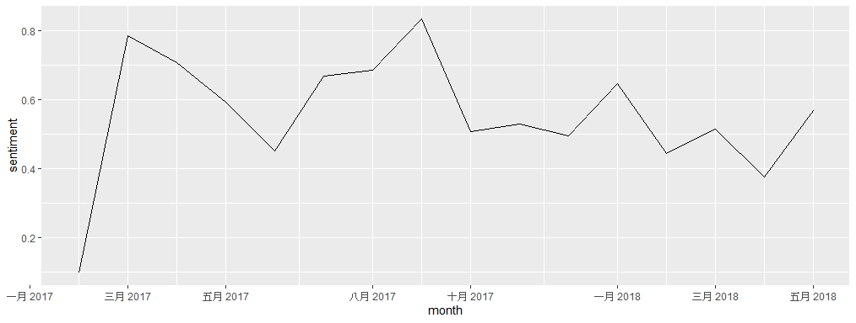
05
Sentiment Analysis
Introduction
library(ggplot2)
ggplot(trump_sent_ym, aes(month, sentiment)) +
geom_line()

Slide 45
Midterm Exam
Notes:
https://books.psychstat.org/textmining/association-of-words.html#pairwise-association

Slide 46
02
Midterm Exam
Items | Points | %
Midterm Exam | 200 | 15.38%
Midterm exam will be held on April 21 (week 10)
Open books and reference cards.
You can use web browsers to search the solutions, but can’t use any social media in your laptops and smart phones.
Using R-studio on your laptop

Slide 47
02
Midterm Exam
The midterm exam will cover the contents I taught from Week 1-9.
I will upload a midterm exam notice before the next week class.
Don’t worry about the midterm, the level of difficulty and the mode are similar your homeworks, but you have to finish it in the class.

Slide 48
Data Project

